Slide 1

POTATO PLANT DISEASE DETECTION USING DEEP LEARNING
PRESENTED BY :
Meghana Reddy Mynampati(20311A1234) Chelukali Ashish Kumar(20311A1243)
Panga Saikiran(21315A1205)

Slide 2

CONTENTS :
Abstract
Introduction
Literature Survey
Existing System
Proposed System
Flow Chart
Procedure
Requirements
Best and Worst Inferences
Output Screens
Conclusion
Future Scope
References

Slide 3
ABSTRACT :
The identification of plant disease in potato plant is an imperative part of crop monitoring systems. This research performed the complex tasks of localization and classification of the disease in potato plant leaves. Deep Learning rich libraries and user as well as developer friendly environment to work with, all these qualities make Deep Learning as the favourable method to get started with this problem. In this, we have used Deep Learning because of the advantages it offers to work with images especially in image classification to get improvised results. The methodology includes taking leaves of infected crops and label them as per the disease pattern. In the future, the proposed detection methodology can also be adopted for other agricultural applications.

Slide 4
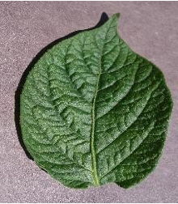
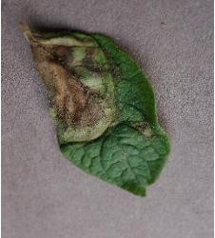
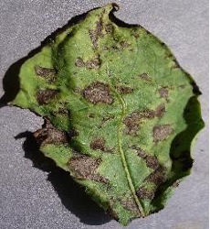
INTRODUCTION :
Potato plant disease detection with deep learning uses smart technology to quickly spot and handle diseases in potato crops. It studies detailed patterns in data to catch problems early, keeping the plants healthy, and increasing farm productivity.
Potato_healthy
Potato_late_blight
Potato_early_blight

Slide 5
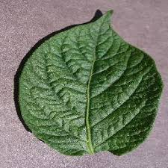
LITERATURE SURVEY :
Potato plant disease detection using deep learning explores various research studies and articles focusing on smart technology that can quickly and accurately identify diseases in potato crops.
The major area for potato plant disease detection using deep learning is image analysis, with Convolutional Neural Networks (CNN) being a key subarea.

Slide 6
The evolution of potato plant disease detection using deep learning has seen remarkable progress in recent years.
From simple image recognition techniques, it has evolved to sophisticated Convolutional Neural Networks (CNNs) that efficiently analyze vast amounts of data, empowering farmers with accurate and timely disease identification for better crop protection and improved agricultural outcomes.
Evolution in this field shows a shift towards more sophisticated networks and larger datasets, leading to enhanced disease recognition and early intervention for farmers.
These developments empower sustainable agricultural practices, reducing crop losses, and ensuring food security amidst plant disease challenges.

Slide 7
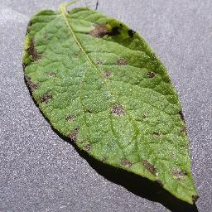
EXISTING SYSTEM :
Before the widespread adoption of deep learning, potato plant disease detection predominantly relied on traditional computer vision and machine learning techniques.
Some of the existing systems for potato plant disease detection before deep learning include :
Rule-Based Systems
Image Processing Techniques
Color-Based Segmentation
Texture Analysis
Machine Learning with Handcrafted Features.

Slide 8
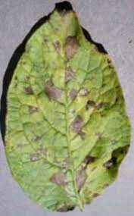
PROPOSED SYSTEM
While the existing systems provided valuable groundwork for disease detection in potato plants, they often faced challenges related to accuracy, adaptability to new diseases, and robustness to diverse environmental conditions.
With the introduction of deep learning and CNNs, the field of potato plant disease detection witnessed significant advancements, achieving higher accuracy and scalability.
Deep learning models have become the state-of-the-art approach for disease detection, offering superior feature extraction and classification capabilities, enabling more accurate and reliable detection of potato plant diseases.

Slide 9
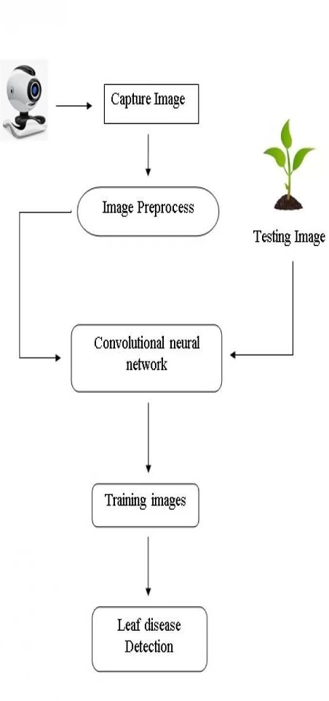
FLOW CHART

Slide 10
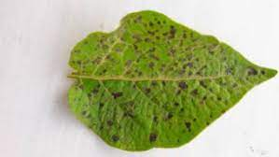
PROCEDURE :
1. Data Collection:
Gather a diverse and representative dataset of potato plant images, including both healthy plants and plants affected by various diseases. The dataset should cover different disease types and severity levels. Below is the link for dataset:
https://www.kaggle.com/datasets/arjuntejaswi/plant-village
2. Data Preprocessing:
Perform image resizing, normalization, and data augmentation techniques like flipping and rotation to prepare the potato plant images for deep learning model training.

Slide 11
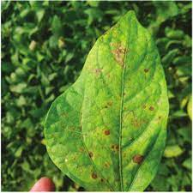
3. Data Split:
Divide the dataset into three subsets: training, validation, and testing sets. The training set is used to train the deep learning model, the validation set is used to tune hyperparameters and prevent overfitting, and the testing set is used to evaluate the model's performance on unseen data.
4. Design the Deep Learning Model:
Choose an appropriate deep learning architecture for image classification tasks, such as Convolutional Neural Networks (CNNs).

Slide 12
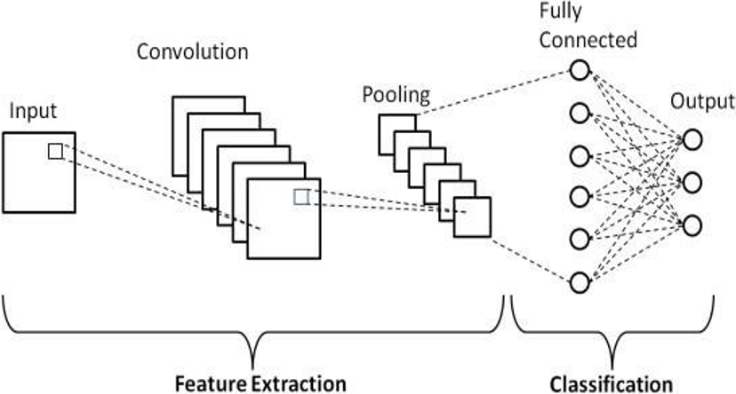
BLOCK DIAGRAM OF CNN

Slide 13
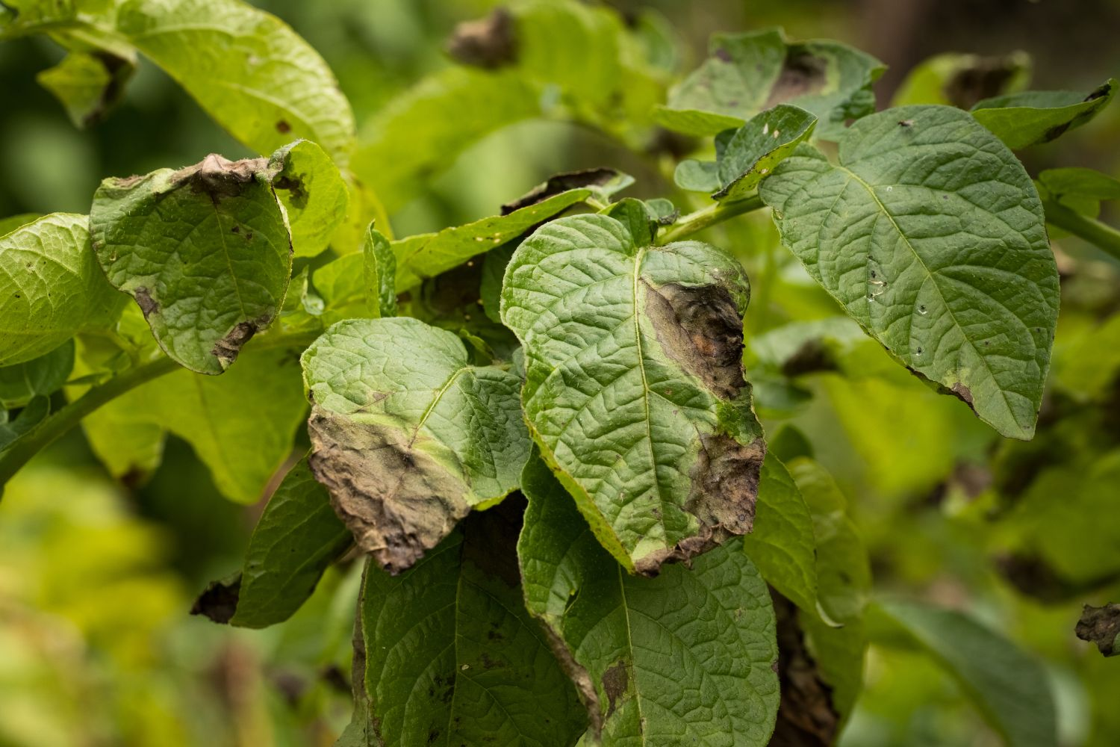
5. Model Construction:
Build the deep learning model and define the layers, activation functions, and other hyperparameters. Include a final classification layer with the number of output classes representing different potato plant diseases.
6. Model Training:
Train the model using the training dataset. During training, the model learns to recognize patterns and features associated with different potato plant diseases. Use an optimization algorithm like Adam to update the model's weights and minimize the loss function.

Slide 14
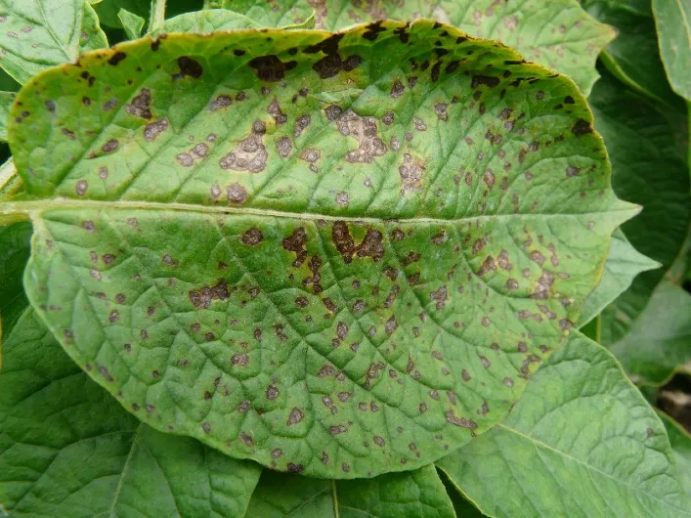
7. Model Evaluation and Visualization
Evaluate the trained model using the test dataset and visualize the training and validation accuracy and loss over epochs. Compute its accuracy and performance metrics, such as confidence and confusion matrix. This step ensures that the model performs well on unseen data and generalizes effectively.
8. Prediction
Use the trained model to make predictions on new unseen images and visualize the predicted class labels and their corresponding confidence scores.

Slide 15
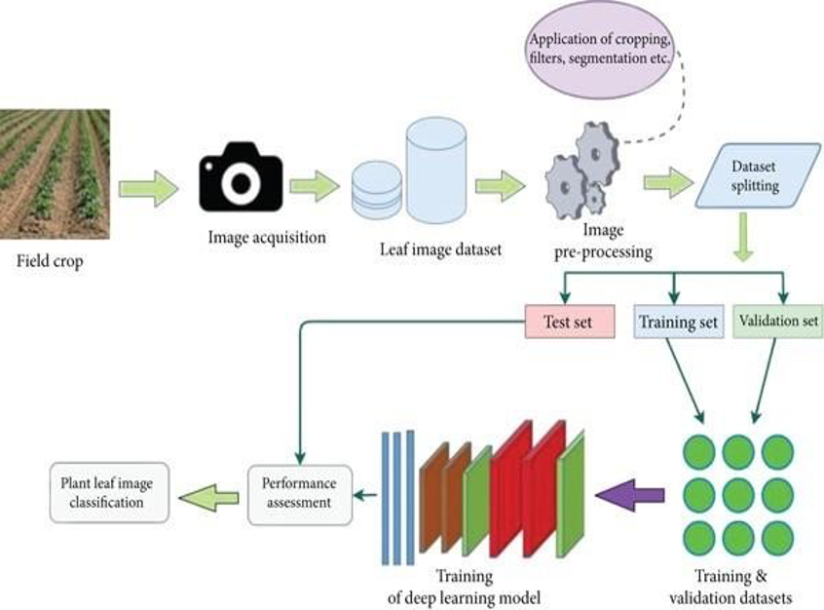

Slide 16
SOFTWARE REQUIREMENTS :
The software requirements for potato plant disease detection using deep learning include Python, TensorFlow or Keras for building neural network models, and NumPy for numerical computations.
Matplotlib is needed for data visualization, and PIL (Python Imaging Library) is essential for image handling.
A GPU-enabled environment is recommended for faster training. For a user-friendly setup, platforms like Google Colab or Jupyter Notebook are ideal, offering pre-installed libraries and cloud-based resources for access to powerful GPUs.
These tools facilitate interactive development and seamless execution of Python code, making the implementation process efficient and cost-effective.

Slide 17
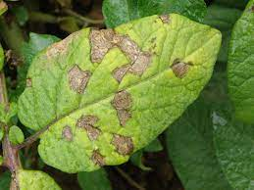
HARDWARE REQUIREMENTS :
For potato plant disease detection using deep learning, a computer with a modern multi-core CPU and at least 8GB RAM is sufficient.
A high-performance GPU is recommended to accelerate training.
GPUs can significantly speed up computations and reduce training time.
Cloud-based solutions like AWS, Google Cloud, or Microsoft Azure offer access to powerful GPU instances.
For large-scale projects, distributed computing and high-performance clusters may be needed.

Slide 18
FUNCTIONAL REQUIREMENTS :
Functional requirements for potato plant disease detection using deep learning include image dataset collection, data preprocessing, model development, training, validation, and testing.
The system should accurately classify images into healthy or diseased plants.
It should provide real-time predictions and support scalability for future expansion. User-friendly interfaces for data input and result visualization are essential.
Additionally, the system should allow easy integration with other agricultural technologies and provide regular updates to improve model performance and accuracy.

Slide 19
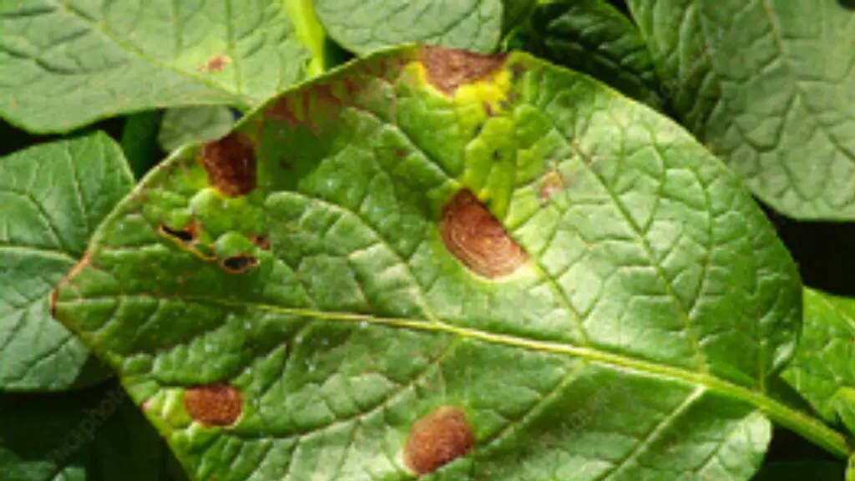
BETTER AND WORST INFERENCES :
Inferences in potato plant disease detection using deep learning can vary in accuracy.
Better inferences occur when the model accurately classifies and detects diseases, helping farmers apply targeted treatments, preventing crop losses.
However, worst inferences happen when the model misclassifies healthy plants as diseased or vice versa, leading to incorrect treatment decisions and potential crop damage.
Continuous model improvement, data augmentation, and regular updates can help mitigate worst inferences and enhance overall performance.

Slide 20
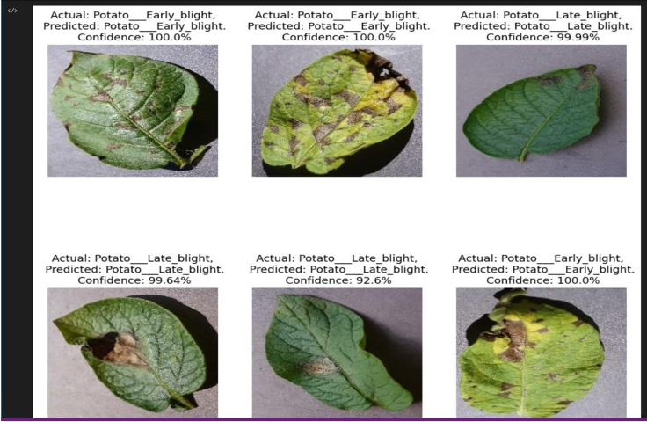
OUTPUT SCREENS :

Slide 21
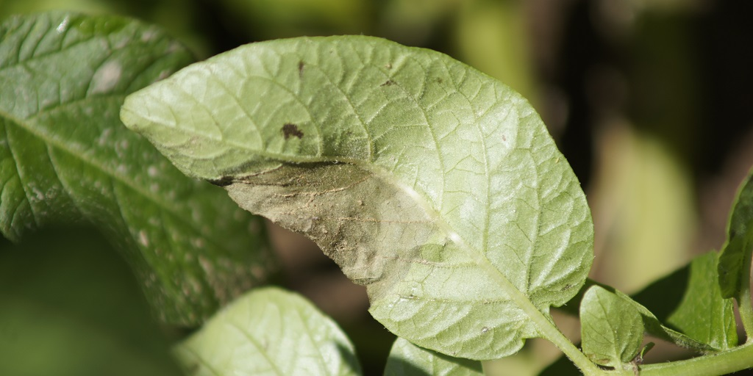
CONCLUSION :
Deep learning-based potato plant disease detection shows promising results in accurately identifying diseases based on images. The CNN model achieved good accuracy during evaluation, making it a valuable tool for early disease detection in potato crops. With further improvements and fine-tuning, the system's performance can be enhanced, leading to more reliable predictions. This technology has the potential to aid farmers in timely disease management, reducing crop losses and improving overall agricultural productivity. However, continuous monitoring, regular updates, and additional data can contribute to the system's robustness and reliability in real-world scenarios.

Slide 22
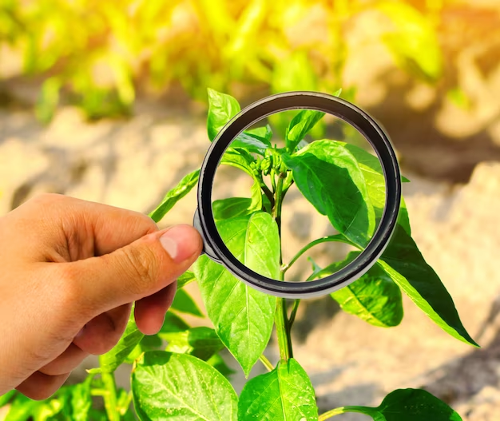
FUTURE SCOPE :
The future scope of potato plant disease detection using deep learning is promising. Advancements in deep learning algorithms and access to larger datasets can further improve the accuracy and robustness of the models. Integration with IoT devices and drones can enable real-time monitoring of large agricultural fields, facilitating early disease detection and targeted treatment. Additionally, the development of user-friendly mobile applications can empower farmers to use this technology more effectively. Collaborative efforts among researchers, agricultural experts, and technology developers can drive innovation in this field, leading to more efficient and sustainable agriculture practices, ultimately benefiting farmers and food security on a global scale.

Slide 23
REFERENCES :
E. Hirani, V. Magotra, J. Jain and P. Bide, "Plant Disease Detection Using Deep Learning," 2021 6th International Conference for Convergence in Technology (I2CT), Maharashtra, India, 2021, pp. 1-4, doi: 10.1109/I2CT51068.2021.9417910.
A. Sharma, K. Lakhwani and H. Singh Janeja, "Plant Disease Identification Using Deep Learning: A Systematic Review," 2021 2nd International Conference on Intelligent Engineering and Management (ICIEM), London, United Kingdom, 2021,
pp. 222-227, doi: 10.1109/ICIEM51511.2021.9445277.
Chohan, Murk, et al. "Plant disease detection using deep learning." International Journal of Recent Technology and Engineering 9.1 (2020): 909-914.

Slide 24
THANK YOU

